Slide 1
Ergonomics
Ammar Khan
Umer Abdul Khaliq
Taimoor Azam

Slide 2
Definition
Ergonomics is the scientific discipline concerned with the understanding of interactions among humans and other elements of a system.
To goal is to facilitate the interaction to achieve maximum performance.

Slide 3
Driving Factors
Massive interface optimization was pushed to incorporate as many people as possible.
The companies like Apple, Microsoft , Google and many other brought massive amount of people into the realm of computers.
For that to have happen, the learning curve had to be decreased.
The interface should be self-explanatory.
Utilities had to be defined. In some devices, hardcoded into the system.

Slide 4
Interface and Interaction
An interface can be defined as the sum of the hardware and software components through which a system is operated and users informed of its status.
The interface includes everything the user perceives, understands and manipulates while interacting with the computer .
It is therefore a crucial determinant of the human-machine relation.
Research on interfaces aims at improving interface utility, accessibility, performance and safety, and usability.
Utility is defined with reference to the task to be performed

Slide 5
Accessibility
Measure of an interface’s ability to allow several categories of users.
Users can be:
Professionals
Non-Professionals
Handicapped
Dumb

Slide 6
Performance
In terms of interface design, the performance is the degree to which a system improves the efficiency with which users perform their work.
May include:
Menu Shortcuts
Prioritize functions in terms of viewing area
Key binding
Machine-learning for auto filling

Slide 7
Safety
The safety of a system is defined by the extent to which an interface allows users to perform their work free from the risks.
Factors:
Human
Equipment
Data
Environmental accidents
Losses

Slide 8
Interface Advantages for Developers
Better product image
Increased demand for products
Shorter training times
Lower after-sales service requirements
Solid base upon which to develop a product line
Reduction of the risk of errors and accidents
Reduction of documentation.

Slide 9
Interface Advantages for Users
Shorter learning phase
Increased general applicability of skills
Improved use of the system
Increased autonomy using the system
Reduction of the time needed to execute a task
Reduction in the number of errors
Increased satisfaction.

Slide 10
A Design Philosophy Focused on the User
Immediate and continuous attention to users. Direct contact with users is maintained, in order to better understand their characteristics and tasks.
Integrated design. All aspects of usability (e.g., interface, manuals, help-systems) are developed in parallel and placed under centralized control.
Immediate and continuous evaluation by users. Users test the interfaces or prototypes early on in the design phase, under simulated work conditions. Performance and reactions are measured quantitatively and qualitatively.
Iterative design. The system is modified on the basis of the results of the evaluation, and the evaluation cycle started again.

Slide 11
Ergonomic Task Analysis
The process by which user responsibilities and activities are elucidated.
This in turn allows interfaces compatible with the characteristics of users’ tasks to be designed.
The nominal task, corresponding to the organization’s formal definition of the task. This includes objectives, procedures, quality control, standards and tools.
The real task, corresponding to the users’ decisions and behaviours necessary for the execution of the nominal task.
The gap between nominal and real tasks is inevitable and results from the failure of nominal tasks to take into account variations and unforeseen circumstances in the work flow, and differences in users’ mental representations of their work.

Slide 12
Activity Analysis
Activity analysis examines elements such as work objectives, the type of operations performed, their temporal organization (sequential, parallel) and frequency.
The operational modes relied upon, decisions, sources of difficulty, errors and recovery modes.
This analysis reveals the different operations performed to accomplish the task (detection, searching, reading, comparing, evaluating, deciding, estimating, anticipating), the entities manipulated.

Slide 13
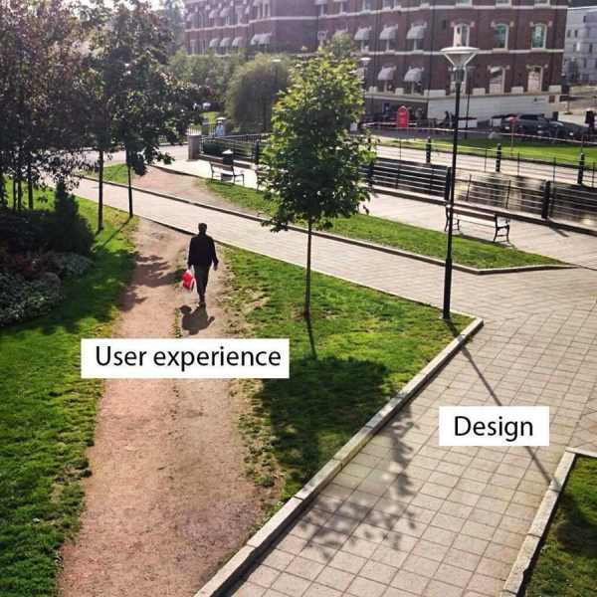
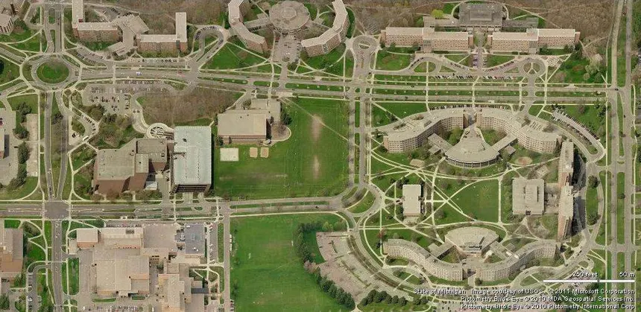
Nominal Task vs Real Task

Slide 14
Step of Task Analysis
Data collection
Compilation and analysis
Developing prototypes or simulations to check the gap
Repeat these steps in developing, testing and production phase of the product.

Slide 15
Cognitive Ergonomics
Hierarchical task analysis consists of the division of tasks (or main objectives) into sub-tasks, each of which can be further subdivided, until the required level of detail is attained.
Data is collected directly from users (e.g., through interviews, vocalization), hierarchical division can provide a portrait of users’ mental mapping of a task.
The results of the analysis can be represented by a tree diagram or table, each format having its advantages and disadvantages.

Slide 16
Learning
Analogy plays a large role in user learning.
Use of appropriate analogies or metaphors in the interface facilitates learning, by maximizing the transfer of knowledge from known situations or systems.
Users generally prefer to learn new software by using it immediately rather than by reading or taking a course—they prefer action-based learning in which they are cognitively active.
Names of commands and menus, symbols, icons, codes (e.g., shape, color) and messages can be analogous to their function or its popular use case.

Slide 17
Mental Representation
The mental models users construct of the systems they use reflect the manner in which they receive and understand these systems.
These models therefore vary as a function of users’ knowledge and experience.
In order to minimize the learning curve and facilitate system use, the conceptual model upon which a system is based should be similar to users’ mental representation of it.
The mental model is characterized by the very fact that it is personal (Rich 1983), incomplete, variable from one part of the system to another, possibly in error on some points and in constant evolution.
Researches shows that users will perform poorly in the absence of an adequate mental model.

Slide 18
User Analysis
The other pillar of interface design is the analysis of user characteristics.
Considerations:
Age
Sex
Language
Culture
Training
Perception
Memory
Cognitive Mapping
Decision Making
Learning

Slide 19
Unavoidable Errors
It should be recognized that users make mistakes when using systems, regardless of their skill level or the quality of the system.
One of the causes of errors is users’ reliance on correction rather than prevention strategies.
Users prefer acting rapidly and incurring errors that they must subsequently correct, to working more slowly and avoiding errors.
In addition, systems should be fault tolerant and should incorporate effective error management.

Slide 20
Conclusion
Interface development has highlighted the major stakes and broad trends in the field of human-computer interaction.
Ergonomics can help us understand that processes and methods that helps us boost user-system interaction performance.
Task, user, and needs analysis play an essential role in understanding system requirements and, by extension, necessary interface features.
Prototyping and user evaluation are indispensable for the determination of interface usability.

